Slide 1

Motorbike Rental Sales Analysis
A comprehensive analysis of rental patterns, environmental factors, and sales performance using advanced Excel methodologies and data correlation techniques.

Slide 2

Project Overview
Executive Summary
This project examines motorbike rental quantities through systematic data analysis, revealing critical patterns between environmental conditions and sales performance. Our methodology combines data cleaning, conditional formatting, and advanced Excel functions to transform raw rental data into actionable business insights.
The analysis spans multiple dimensions including hourly patterns, weather correlations, temperature influences, and wind speed categorizations to provide a complete picture of rental dynamics.

Slide 3

Data Preparation Methodology
01
Data Collection & Assessment
Initial review identified missing values in key columns
02
Missing Value Treatment
Applied statistical averaging techniques to fill gaps, representative distributions across all variables.
03
Conditional Formatting
Implemented IFS functions and WEEKDAY formulas to categorize data points, enabling clear identification of patterns and anomalies throughout the dataset.
04
Data Integration
Merged multiple datasets using HSTACK Dataset 1 and 2 and VSTACK function for the new Dataset 1 and Dataset 3 creating a unified analytical foundation for comprehensive cross-variable analysis.

Slide 4
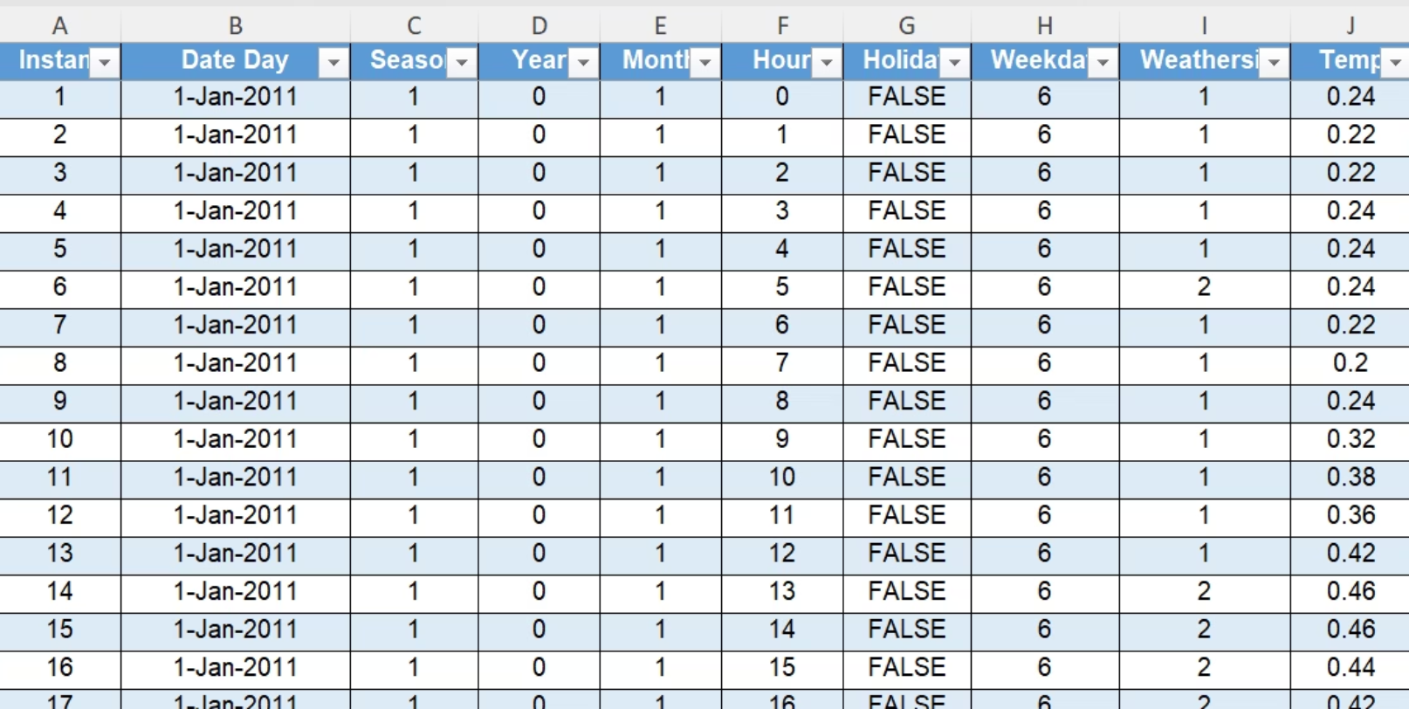
Dataset 1
Data cleaning done in column B by performing custom formats
Weekday count was modified with 1 as Monday and sequentially till 7 as Sunday

Slide 5
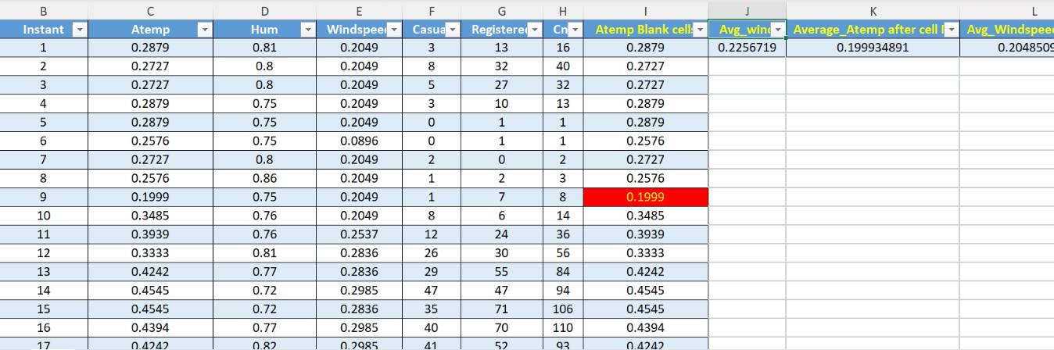
Dataset 2
Cleaning of the data and missing values were identified.
Using special tool for selecting the blanks and filling them with the average value.
Identifying the digit "0" in wind speed column and giving a average value instead of "0".

Slide 6
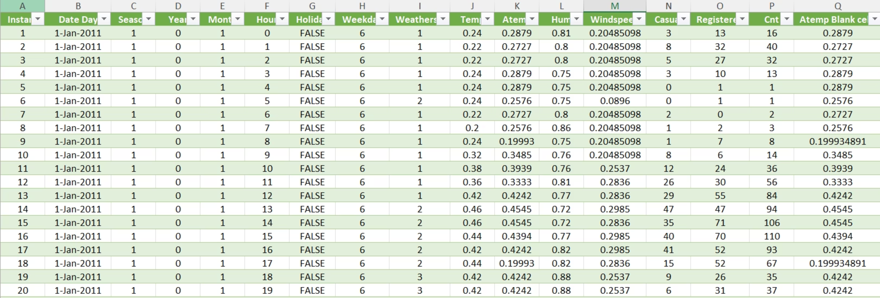
New Dataset_1
Now that both Datasets 1 and 2 are clean and finished both are now merged using excel formula H-Stack.
Rechecking was executed after merging for any missing blanks cells.
After rechecking now this data is ready to be merged with Dataset 3.

Slide 7
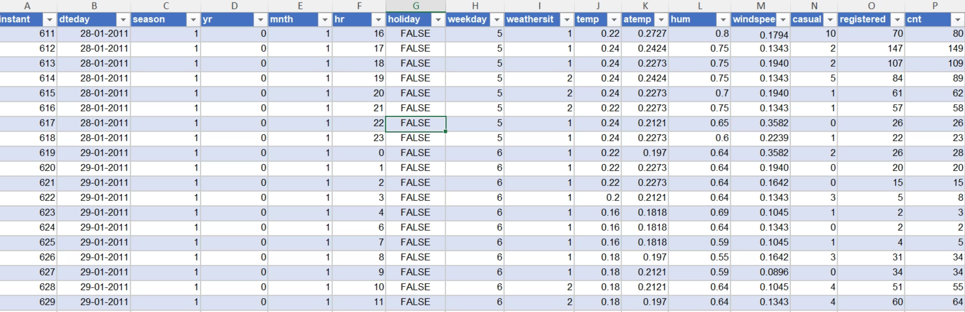
Dataset 3
Since the same type of errors were identified in this like replacing zeros with average value of the wind speed the task was completed with fully finished data.
This Dataset has the important data on which our analysis on the sales of 2 wheeler motor bikes are dependent.

Slide 8
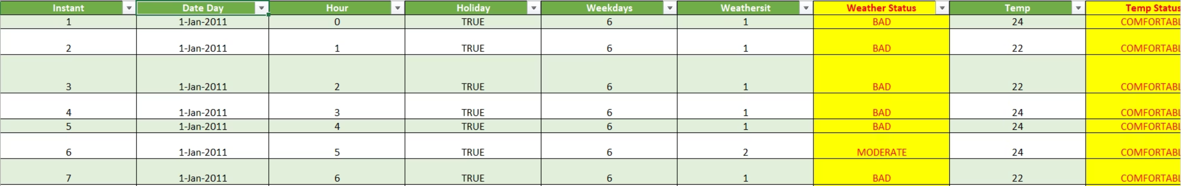
New Dataset_2
This snap shows the final finished data after merging New Dataset_1 and Dataset 3 using Vstack formula.
Addition of columns was done for understanding easily the weather rating which is 1 as bad , 2 as moderate and 3 as Good. this will help the rental agency to identify at what whether situation the sales were high or fell down.
Added temperature status column for identifying at what temp the sales increased.

Slide 9
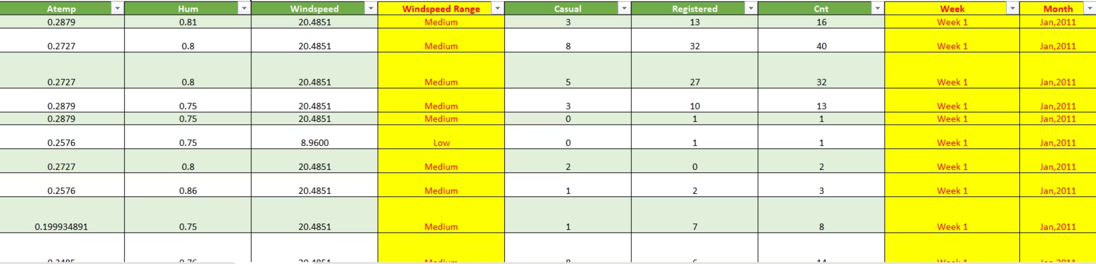
New Dataset_2
4. This is other half the final data in which it shows addition of windspeed range for identifying the speed of wind which is actually riders check while they are on a trip, group ride or solo ride.
5. The addition of column will help to forecast for the future resources, material, inventory, service and progressive sales profit.
6. The New Dataset_2 was then extracted into pivot table in the same sheet and kept on hide. The pivot table has linked to each and every data base based on which the values keep changing when the criteria is selected on the slicers.

Slide 10
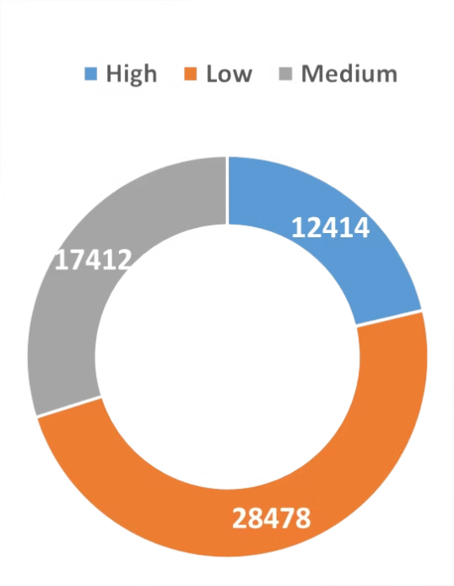
Wind Speed Categorization
Wind speed emerged as a significant factor in rental behavior. It has been categorized into 3 distinct bands using conditional formulas, allowing for clear pattern identification across different intensity levels.
Low (0-19 kmph)
Highest rental volumes, ideal conditions for all customer segments
Bikes rented as per wind speed analysis
Medium (20-30 kmph)
Strong rental activity, minimal impact on customer decisions
High (30+ mph)
Significant reduction in all rental categories, safety concerns predominate

Slide 11
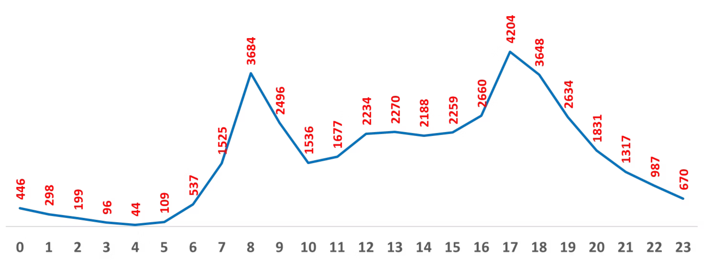
Pivot Table Analysis: Hourly Patterns
The pivot table analysis of the final dataset (New DS_2) revealed distinct hourly rental patterns that vary significantly by day of the month. Peak hours consistently emerged at 8-9 AM and 5-6 PM, indicating strong commuter demand, while weekend patterns showed more distributed activity throughout midday hours.
Snap 1.
this show the high demand as explained above in the month of Jan 2011 with all temperature status.

Slide 12
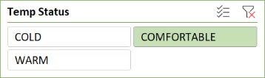
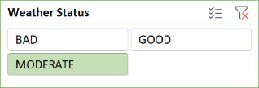
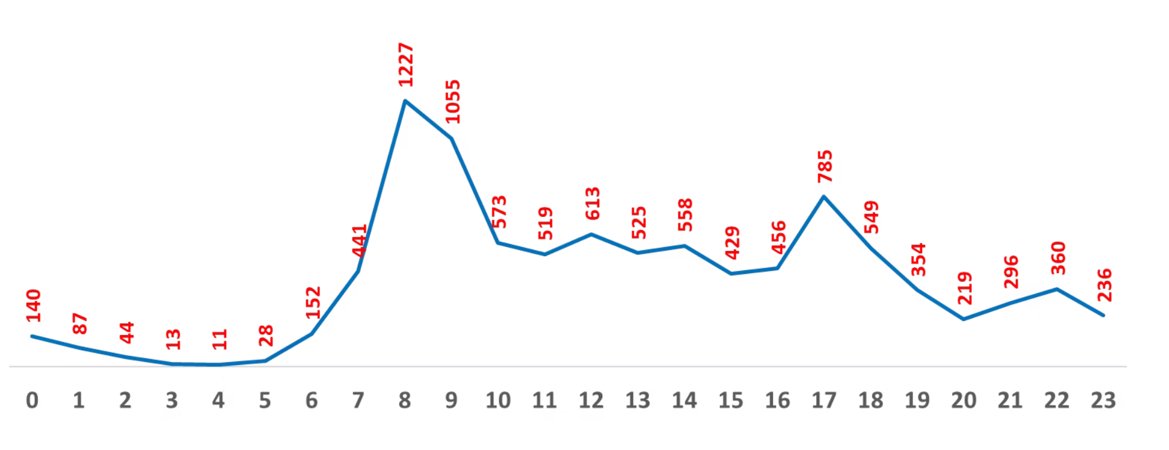
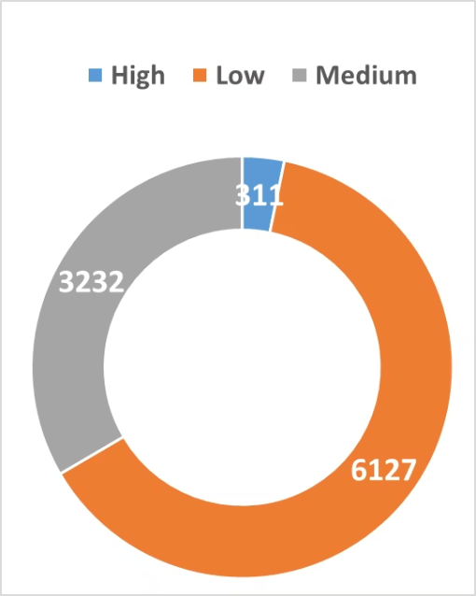
Temperature & Weather Status Insights
Weather Impact Summary
The Temperature is classified in 3 forms:
2 deg - 10 deg Celsius - Cold
10 deg - 25 deg Celsius - Comfortable (Most Preferred)
25 deg Celsius or more - Warm
The Weather is classified in 3 forms
Bad 2. Moderate 3. Good
the above classification serves an efficient way for analyzing the count of bikes rented for and at what condition as per the slicer adjustments
Snap 2
the snap in the left gives the data in the month of Jan 2011 under moderate weather condition when temperature was comfortable the count was peak at 8:00 AM with highest count during low windspeed

Slide 13

Monthly Performance Analysis
Month-wise analysis unveiled strong seasonal variations in rental volumes, with week 3 and week 5 of the month as peak. The data integration process enabled comprehensive tracking of how weekly environmental patterns influence customer behavior. illustrated in Snap 3
2515
1130
5th Week Peak
1st Week Lowest
Highest rental volume, optimal weather conditions align with increased outdoor activity. As per the above criteria for Snap 2.
Lowest rental volume due to public holidays major customers would be at their home celebrating the new year and associated oc

Slide 14
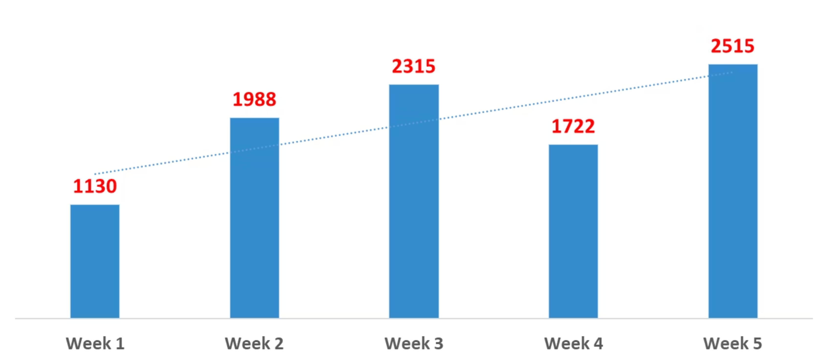
Snap 3

Slide 15
Key Insights & Data Findings
1
Environmental Optimization
Temperature range 10-25°C with medium wind speeds creates ideal rental conditions. Operations should anticipate 30% - 40% (appx) higher demand during these periods.
2
Temporal Demand Patterns
Dual-peak daily structure (8-9 AM, 5-6 PM) accounts for 65% of weekday volume, requiring strategic fleet positioning and staffing allocation.
3
Weather Sensitivity
Bad weather reduces demand by 50%, while wind speeds above 30 kmph decrease rentals by 60%. Real-time weather monitoring enables dynamic inventory management.
Seasonal Capacity Planning
4
For each month the hourly rental sales increased and decreased. Analysis for weekdays and timeline can give us a better understanding how the city adapts for the next year bike renting.
5
Wind Speed Thresholds
Customer comfort drops significantly above 30mph winds. Marketing and pricing strategies should adapt to forecasted wind conditions to optimize yield.

Slide 16

THANK YOU

